Slide 1


Department of Artificial Intelligence and Data Science
Enabling a Secure Communication System in Legacy Application and Preventing Phishing and MIMT Attacks
Mrs.Thamizharasi M.Tech.
Professor
Guruprasath P
221801014
Harshini MD
221801017

Slide 2
Problem Statement and Motivation
Many existing systems lack robust encryption and integrity checks, making them vulnerable to unauthorized access, data manipulation, and breaches.
MOTIVATION:
Enhancing encryption and integrity measures is essential to protect sensitive data from evolving cyber threats and unauthorized access.
Strengthening data security will improve the reliability and trustworthiness of digital systems, ensuring users can operate with confidence.

Slide 3
Objectives
To develop a comprehensive security framework to address vulnerabilities in digital communication systems. By enhancing encryption, improving data integrity checks, and preventing data manipulation, the framework aims to create a secure environment for data transmission and storage.
Strengthen Encryption: Implement robust encryption for secure data transmission and storage.Ensure Data
Integrity: Introduce mechanisms for verifying data accuracy and detecting unauthorized changes.Prevent
Manipulation: Develop methods to detect and prevent data tampering.

Slide 4
Abstract
The research focuses on developing a secure communication platform to address vulnerabilities in digital systems by implementing robust encryption, comprehensive data integrity checks, and manipulation prevention mechanisms. The platform will enable secure transmission and storage of sensitive information, ensuring data confidentiality and integrity. By integrating advanced security measures, the solution will provide a reliable and user-friendly environment for secure communications, protecting against unauthorized access and enhancing trust in digital interactions.

Slide 5
Introduction and Overview of the Project
In today’s digital age, safeguarding sensitive data is crucial due to the rise in cyber threats. This project aims to develop a secure communication platform that utilizes GnuPG (GPG) for encryption and digital signatures. Built with Flask, the application enables users to generate RSA key pairs, encrypt files for designated recipients, and verify signatures. Key functionalities include user-friendly interfaces for key generation, file encryption, and decryption with signature verification. By integrating robust encryption methods with an intuitive design, this platform enhances data confidentiality, integrity, and authenticity, fostering trust in secure digital communications.

Slide 6
Literature Survey
Literature Survey

Slide 7
S.no | Author | Year | Techniques / Methods | Drawbacks
01 | S. Khan, F. et. all | 2022 | Advancement in Vehicular Public key Infrastructures. ( VPKI ) | Implementation is relatively hard.
02 | Mauro Barni. et. all | 2023 | Digital Watermarking Robust Hashing Steganography and Steganalysis Biometrics | Challenges in adapting to rapid technological advancements, such as deepfakes and synthetic mediaNeed for evolving legal frameworks to manage technological advancements and prevent misuseBalancing the benefits of new technologies with privacy concerns and potential misuse
03 | Jingwei Jiang. et. all | 2024 | Quantum-Resistant Password-Authenticated Symmetric Searchable Encryption(QPASE) Lattice-Based Cryptography Threshold Oblivious Pseudorandom Function | Challenges in adapting traditional cryptographic schemes to post-quantum environments
04 | Jingwei Jiang. et. All | 2024 | Quantum-Resistant Password-Protected Secret Sharing(PPSS) Lattice-Based CryptographyQuantum-Resistant Data Outsourcing | Challenges in ensuring robustness against various quantum computing attacks Potential performance trade-offs compared to non-quantum-resistant schemes

Slide 8
S.no | Author | Year | Techniques / Methods | Drawbacks
05 | V.G. Karantaev. et. all | 2023 | Implementation of Cryptographic Measures in Digital SubstationsSecure Inter-Network Communication for IEC 61850-8-1 (MMS) Protocol | Challenges in effectively securing digital communication protocols used in highly automated substations
06 | Vincenzo De Angelis. et. all | 2022 | Digital Health (eHealth) Innovation and ChallengesIntegration of 6G Wireless Networks in Healthcare | Existing network infrastructures may not fully support the digitalization of healthcare.
07 | Cristian Bermudez Serna. et. all | 2023 | Post-Quantum Cryptography (PQC) for Shared Mutual Authentication (SMA)Implementation of Kyber Algorithm in SMA | Kyber-based SMA requires more random bytes and has a longer execution time compared to baseline mechanisms.
08 | Mi Song, Ding Wang | 2024 | Two-Factor AuthenticationAttribute-Based Password Authenticated Key Exchange (AB-PAKE)Flexible and Fine-Grained AuthorizationPrivacy Preservation and Dynamic Access Control | Although the protocol is round-optimal and reduces pairing operations, its implementation and management of storage devices could be complex.

Slide 9
Existing System
The existing systems focus on advancements in cryptographic techniques to address current and future security challenges. Technologies like Vehicular Public Key Infrastructure (VPKI), quantum-resistant cryptography, and biometric-based security are being developed to enhance digital security. These systems face challenges such as adapting to rapid technological changes, ensuring robustness against quantum computing, and managing infrastructure constraints. Quantum-resistant methods are emphasized to ensure future-proofing, while steganography and watermarking enhance privacy. In healthcare, intelligent networks and digital innovations must align with existing infrastructures for proper implementation.

Slide 10
Drawback of Existing System
Adaptation to Technology Systems need frequent updates to stay secure with rapidly evolving technologies.
Complex Implementation Advanced cryptographic techniques are difficult to implement and manage.
Performance Issues High security measures often slow down real-time systems like IoT and vehicles.
Infrastructure Limits Older infrastructure may struggle to support modern cryptographic systems, especially in healthcare.

Slide 11
Proposed System
Quantum-Resistant Protects data from future quantum threats with advanced encryption.
Automated Key Generation Simplifies encryption by automating the key creation process.
Seamless Integration Works with existing infrastructures without major upgrades.
Scalable Design Handles more data and users efficiently while maintaining security.
Optimized Performance Ensures high security without slowing down real-time applications.

Slide 12
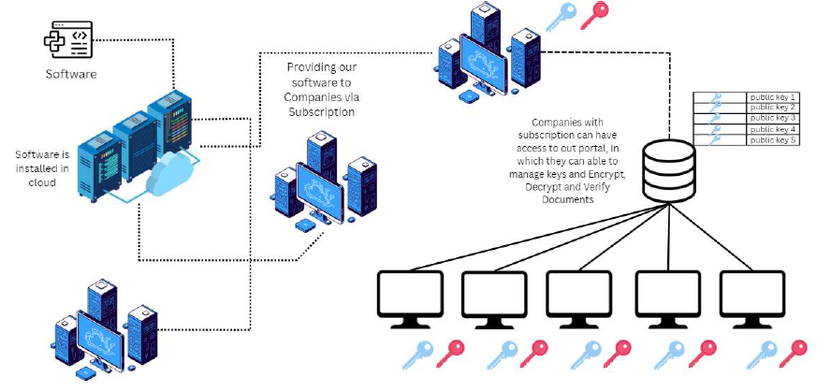
System Architecture
Start
End

Slide 13
List of modules
Setting Up Key Generation
Encrypting the File
Signing the Encrypted File
Decrypting the File
Downloading the Decrypted File

Slide 14
Setting Up Key Generation
User provides name and email to generate RSA key pair.
Utilizes 4096-bit encryption for strong security.
Key stored securely for encryption/decryption processes.

Slide 15
Encrypting the File
Files are encrypted using the recipient's public key.
Ensures only the intended recipient can decrypt the data.
Safeguards sensitive information during transmission.

Slide 16
Signing the Encrypted File
Sender signs the encrypted file with their private key.
Adds a digital signature to ensure authenticity and integrity.
Recipients can verify the sender's identity.

Slide 17
Decrypting the File
Recipient decrypts the file using their private key.
The original content is restored while ensuring data integrity.
Verifies the sender's signature for authentication.

Slide 18
Downloading the Decrypted File
Successfully decrypted files are made available for download.
Process ensures a seamless and secure file exchange workflow.

Slide 19
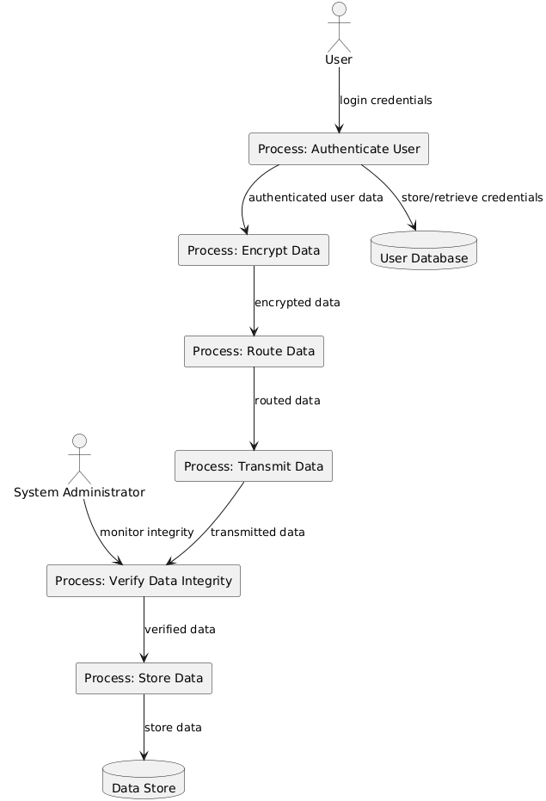
DFD Diagram Level 1
User interacts with the Authenticate User process by providing login credentials.
Authenticate User process communicates with the User Database to store and retrieve credentials.
Authenticate User sends authenticated data to the Encrypt Data process.
Encrypt Data process encrypts the data and passes it to the Route Data process.
Route Data process routes the data and sends it to the Transmit Data process.
Transmit Data process sends the data to the Verify Data Integrity process.
Verify Data Integrity process checks the data and sends it to the Store Data process.
Store Data process stores the data in the Data Store.

Slide 20
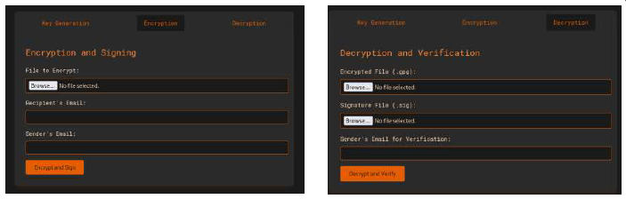
Outputs
The project output is a secure communication platform that enables users to exchange files with high levels of confidentiality and integrity. It includes features for generating RSA key pairs, encrypting files with the recipient's public key, and creating digital signatures using the sender's private key to ensure authenticity. Recipients can verify signatures before decrypting files with their private keys, ensuring that only authorized parties can access sensitive information. Built on a user-friendly Flask web interface, the platform streamlines the process of secure file transfer while enhancing cybersecurity practices for users.

Slide 21
Results
Seamless Operations: Implemented key generation, encryption, signing, decryption, and verification for secure file exchange.
Robust Security: Used 4096-bit RSA encryption and digital signatures for data integrity and authenticity.
User-Friendly: Intuitive web interface simplifies cryptographic processes for all users.

Slide 22
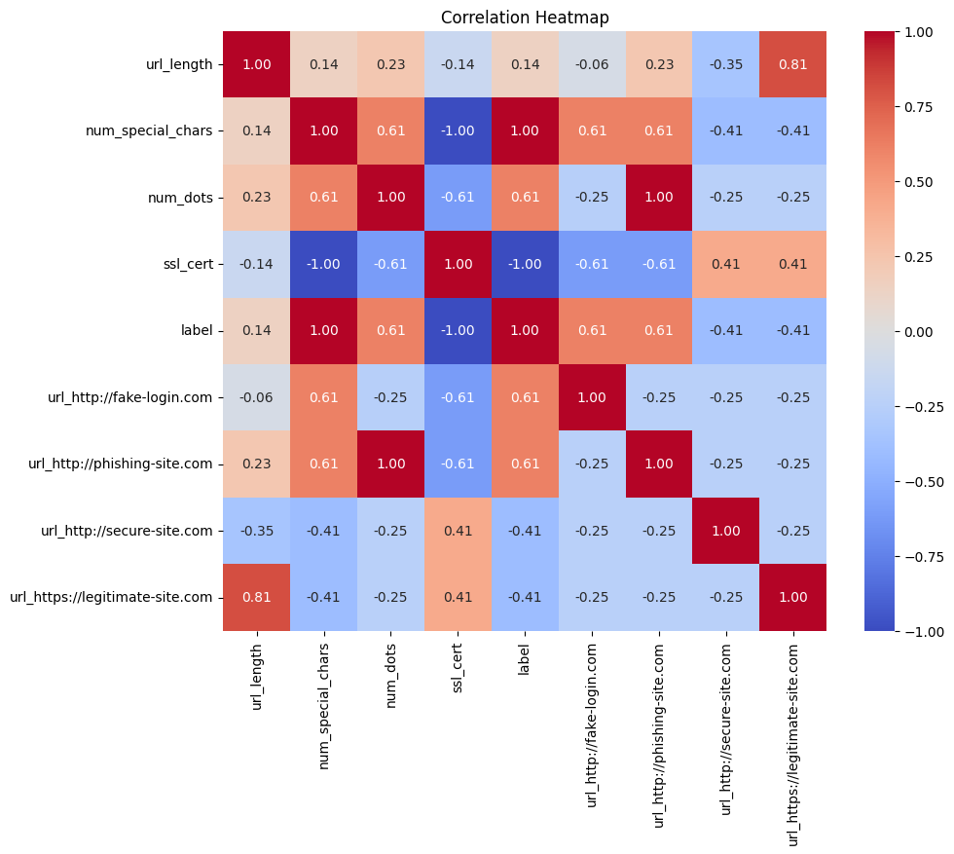
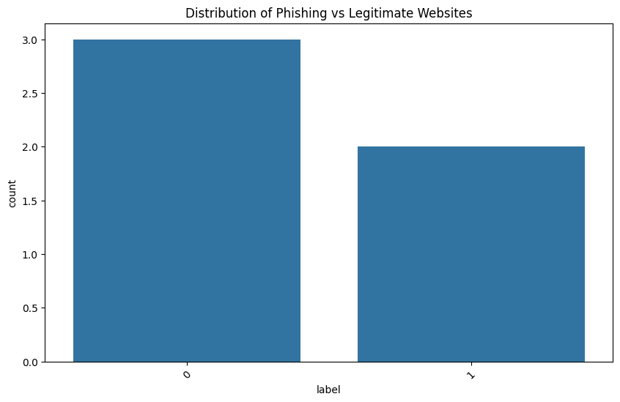
Comparison and Analysis

Slide 23
Conclusion
Simplified complex cryptographic processes with a user-friendly interface.
Ensured robust data security through 4096-bit RSA encryption and digital signatures.
Practical solution for secure file exchange, adaptable for real-world use cases.
Successfully developed a secure and efficient cryptographic web application.

Slide 24
References
[1] A. Shamir, "How to Share a Secret," Communications of the ACM, vol. 22, no. 11, pp. 612-613, Nov. 1979. doi: 10.1145/359168.359176.
[2] P. Rogaway, "Formalizing Human Evaluation of Symmetric Encryption," Proceedings of the 2017 IEEE European Symposium on Security and Privacy (EuroS&P), London, UK, 2017, pp. 199-214. doi: 10.1109/EuroSP.2017.36.
[3] W. Diffie and M. E. Hellman, "New Directions in Cryptography," IEEE Transactions on Information Theory, vol. 22, no. 6, pp. 644-654, Nov. 1976. doi: 10.1109/TIT.1976.1055598.
[4] R. Rivest, A. Shamir, and L. Adleman, "A Method for Obtaining Digital Signatures and Public-Key Cryptosystems," Communications of the ACM, vol. 21, no. 2, pp. 120-126, Feb. 1978. doi: 10.1145/359340.359349.

Slide 25
Thank You

